Slide 1

Copycat cities
Felipe Buchbinder

Slide 2
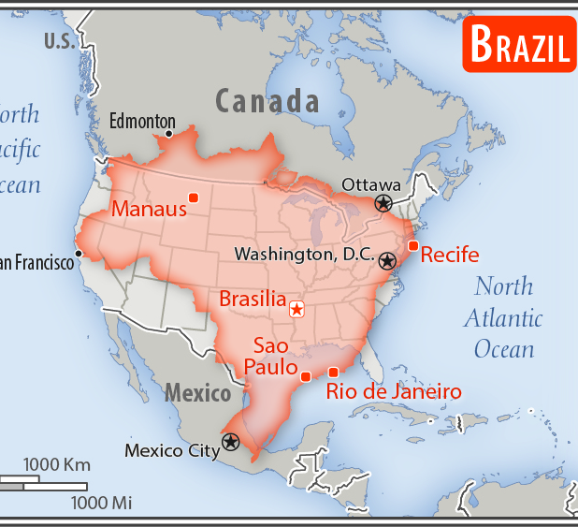
BRAZIL IS BIG
Source: https://www.cia.gov/library/publications/the-world-factbook/geos/print_br.html

Slide 3
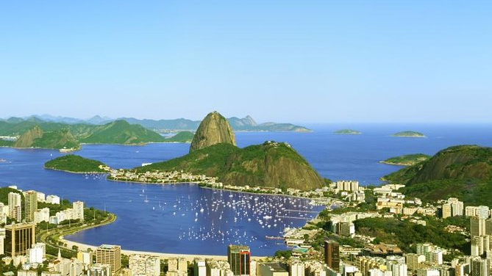
5,423

Slide 4
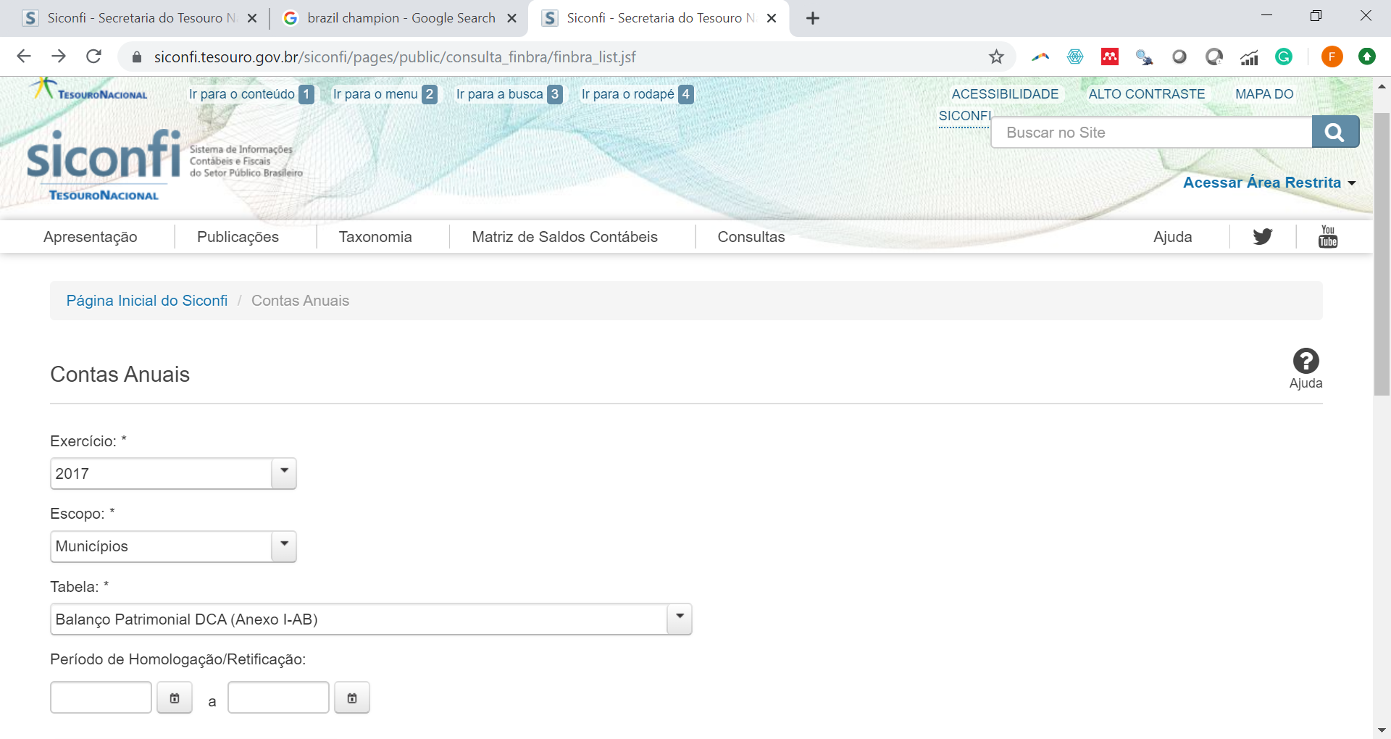

Slide 5

1

Slide 6

Cities copy accounts from one another
Smaller, poorer and less-developed cities are more likely to copy other cities’ accounts.
Cities are more prone to copying accounts from cities which are nearby.
Cities are more prone to copying accounts from cities with which they share the accountant. (Accountant’s blame hypothesis)

Slide 7
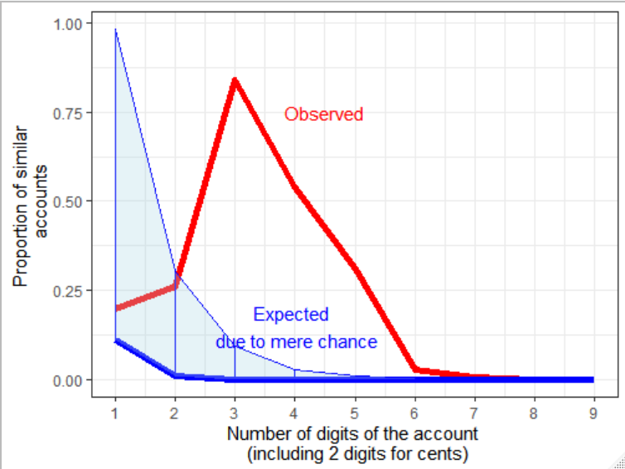
How can we know someone is copying?
How many matches of N-digit accounts would we expect to have due to sheer randomness?
We have many more!
CITIES SEEM TO BE COPYING EACH OTHER!
INSIGHT: Copycat cities copy mostly accounts of small values (Why? Draws less attention?)

Slide 8
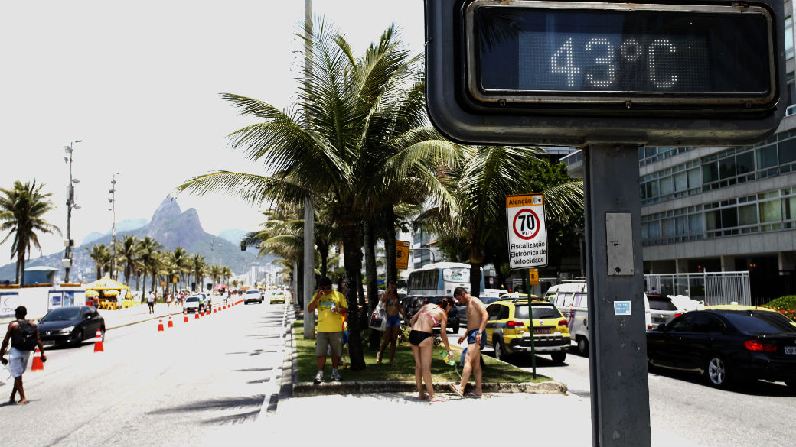

Slide 9


Slide 10
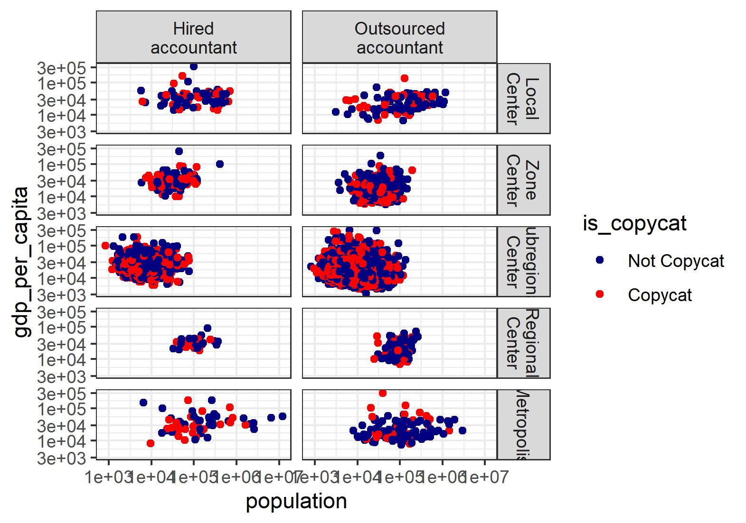

Copycat and non-copycat seem to have the same characteristics.
How to distinguish between them?

Slide 11
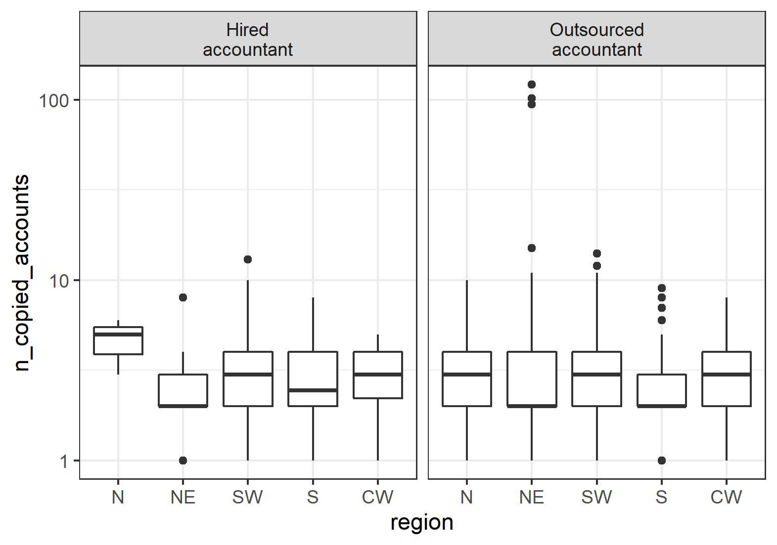

Slide 12
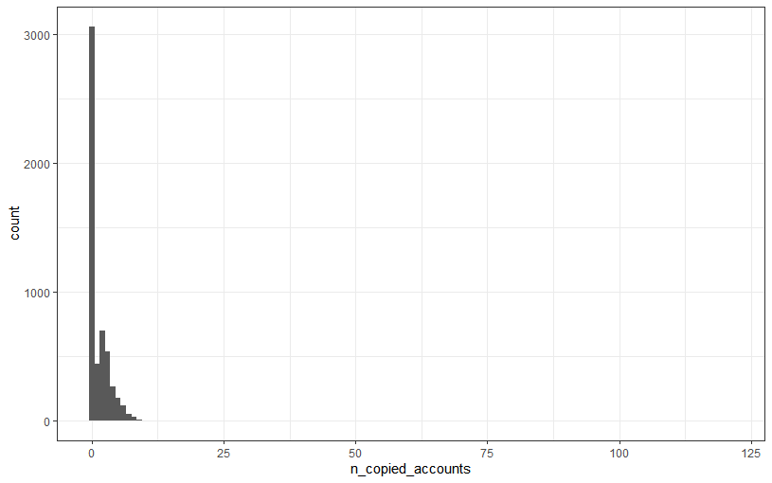
EDA
Number of copied accounts is highly skewed with massive inflation at zero
Covariates are unable to make any clear distinction between copycat and non-copycat cities
Cities in the north with hired consultants are more copycats among the copycats
But the most copycats of all are cities with outsourced accountants in the Northeast

Slide 14
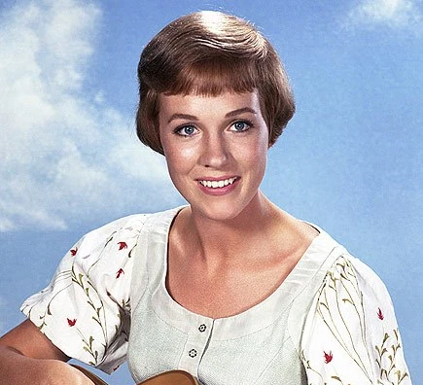

Slide 15

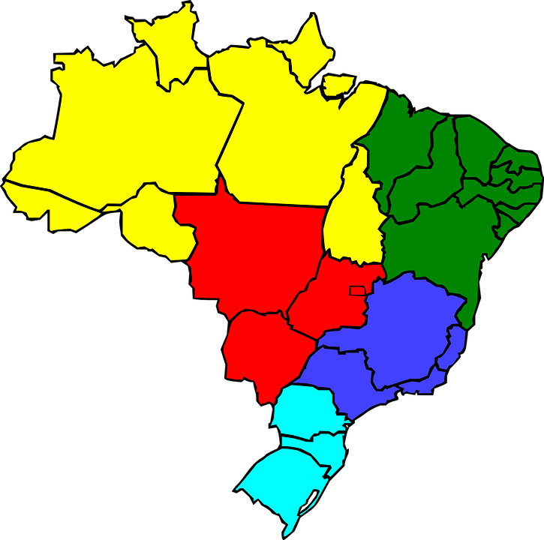

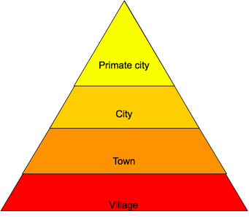
A

Slide 16
Sources of data

Slide 17
"municipality_id" "municipality"
[3] "state" "population"
[5] "n_copied_accounts" "is_copycat"
[7] "gdp" "gdp_per_capita"
[9] "urban_hierarchy" "accountant"
[11] "uncompliant_w_health_ministry" "outsourced_accountant"
[13] "nb_cities_same_accountant"
>

Slide 18
RAW Data
Treasury Department
Balance sheets 2018
Brazilian Institute of Geography and Statistics
GDP
Health Ministry
Accountant’s name and e-mail
Accruals 2018
Population
Region
Level of urbanization
Level of importance of the municipality to its surrounding cities
Submission date

Slide 19
1054061 financial accounts

Slide 20
TREASURY DEPARTMENT
BALANCE SHEETS (2018)
CHANGE IN WEALTH (2018)
SUBMISSION DATES
BRAZILIAN INSTITUTE OF GEOGRAPHY AND STATISTICS
GDP
MINISTRY OF HEALTH

